Slide 1
Introduction to Exceptions in Java

Slide 2
Recall the Array Implementation of a Stack
0
1
2
3
4
5
6
7
…
stack
5
s
top

Slide 3
Incorrect implementation of the pop operation in class ArrayStack
public T pop( ) {
top--;
T result = stack[top];
stack[top] = null;
return result;
}

Slide 4
Let the Main Method be This
public class TestStack {
public static void main (String[] args) {
ArrayStack<String> s = new ArrayStack<String>(5);
String line;
line = s.pop();
. . .
}
}
}

Slide 5
The Program Crashes
public class TestStack {
public static void main (String[] args) {
ArrayStack<String> s = new ArrayStack<String>();
String line;
line = s.pop();
. . .
}
}
When we run this program we get this error message:
Exception in thread “main” java.lang.ArrayIndexOutOfBoundsException: -1
at ArrayStack.pop(ArrayStack.java:87)
at TestStack.main(TestStack.java:6)

Slide 6
Exceptions
Exception: an abnormal or erroneous situation at runtime
Examples:
Array index out of bounds
Division by zero
Illegal input number format
Following a null reference
6

Slide 7
Exceptions
These erroneous situations throw an exception
Exceptions can be thrown by the Java virtual machine or by the program
7

Slide 8
The Error Messages Contain Useful Information
public class ArrayStack<T> implements StackADT<T> {
.
.
.
public T pop( ) {
top--;
87: T result = stack[top];
stack[top] = null;
return result;
}
The error message tells us where the error is:
Exception in thread “main” java.lang.ArrayIndexOutOfBoundsException: -1
at ArrayStack.pop(ArrayStack.java:87)
at TestStack.main(TestStack.java:6)

Slide 9
The Error Messages Contain Useful Information
public class TestStack {
public static void main (String[] args) {
ArrayStack<String> s = new ArrayStack<String>();
String line;
6: line = s.pop();
. . .
}
}
The error message tell sus where the error is:
Exception in thread “main” java.lang.ArrayIndexOutOfBoundsException: -1
at ArrayStack.pop(ArrayStack.java:87)
at TestStack.main(TestStack.java:6)

Slide 10
We Can Fix the Problem by Using Java Exceptions
public T pop( ) {
if (isEmpty( ))
what should we do?
top--;
T result = stack[top];
stack[top] = null;
return result;
}

Slide 11
We Can Fix the Problem by Using Java Exceptions
public T pop( ) throws EmptyCollectionException {
if (isEmpty( ))
throw new EmptyCollectionException(“Stack” );
top--;
T result = stack[top];
stack[top] = null;
return result;
}

Slide 12
Notice the specification of where exceptions are thrown in the Stack ADT
public interface StackADT<T> {
// Adds one element to the top of this stack
public void push (T dataItem);
// Removes and returns the top element of this stack
public T pop( ) throws EmptyCollectionException;
// Returns the top element of this stack
public T peek( ) throws EmptyCollectionException;
// Returns true if this stack is empty
public boolean isEmpty( );
// Returns the number of elements in this stack
public int size( );
// Returns a string representation of this stack
public String toString( );
}
Notes:
We need to provide code for all these methods, which must be declared exactly as stated in the interface.

Slide 13
Ignorig Exceptions
public class TestStack {
public static void main (String[] args) {
ArrayStack<String> s = new ArrayStack<String>();
String line;
line = s.pop();
. . .
}
}
}
If we ignore the exception thrown by method pop,
when running this program we get this error:
Exception in thread “main” EmptyStackException: The Stack is empty.
at ArrayStack.pop(ArrayStack.java.76)
at TestStack.main(TestStack.java:6)

Slide 14
Catching and re-Throwing Exceptions
The calling method can either catch an exception or it can re-throw it.
The method catches the exception if it knows how to deal with the error.
Otherwise the exception is re-thrown.
14

Slide 15
Catching Exceptions
public class TestStack {
public static void main (String[] args) {
ArrayStack<String> s = new ArrayStack<String>();
String line;
try {
line = s.pop();
. . .
}
catch (EmptyStackException e) {
// Error handling code
System.out.println (e.getMessage());
}
. . .
}
}

Slide 16
Catching Exceptions
How try-catch works:
When the try-catch statement is executed, the statements in the try block are executed
If no exception is thrown:
Processing continues as normal
If an exception is thrown:
Program enters in “panic mode” and control is immediately passed to the first catch clause whose specified exception corresponds to the class of the exception that was thrown
16

Slide 17
Catching Exceptions
If an exception is not caught and handled inside the method where it occurs:
Control is immediately returned to the method that invoked the method that produced the exception
If that method does not handle the exception (via a try statement with an appropriate catch clause) then control returns to the method that called it …
This process is called propagating the exception
17

Slide 18
Catching Exceptions
Exception propagation continues until
The exception is caught and handled
Or until it is propagated out of the main method, resulting in the termination of the program
18

Slide 19
Catch Blocks
A single catch block can handle more than one type of exception.
This can reduce code duplication.
In the catch clause we specify the types of exceptions that the block can handle and separate each exception type with a vertical bar (|).
19

Slide 20
A Try-Catch Example with Multiple Catch Statements
The try-catch syntax:
try {
code
}
catch(exception1 e) {statements}
catch(exception2 e) {statements}
catch(exception3|exception4 e){statements}
20

Slide 21
Re-Throwing Exceptions
public class TestStack {
private static void helper (ArrayStack<String> s) throws
EmptyStackException {
String line = s.pop();
. . .
}
public static void main (String[] args) {
ArrayStack<String> s = new ArrayStack<String>();
String line;
try {
helper(s);
. . .
}
catch (EmptyStackException e) {
System.out.println (“Stack empty”+e.getMessage());
}
. . .
}
Method helper re-throws
the exception thrown
by pop()
If the EmptyStackException
were not caught here, the program
would crash

Slide 22
Java Exceptions
In Java, an exception is an object
There are Java predefined exception classes, like
ArithmeticException
IndexOutOfBoundsException
IOException
NullPointerException
22

Slide 23
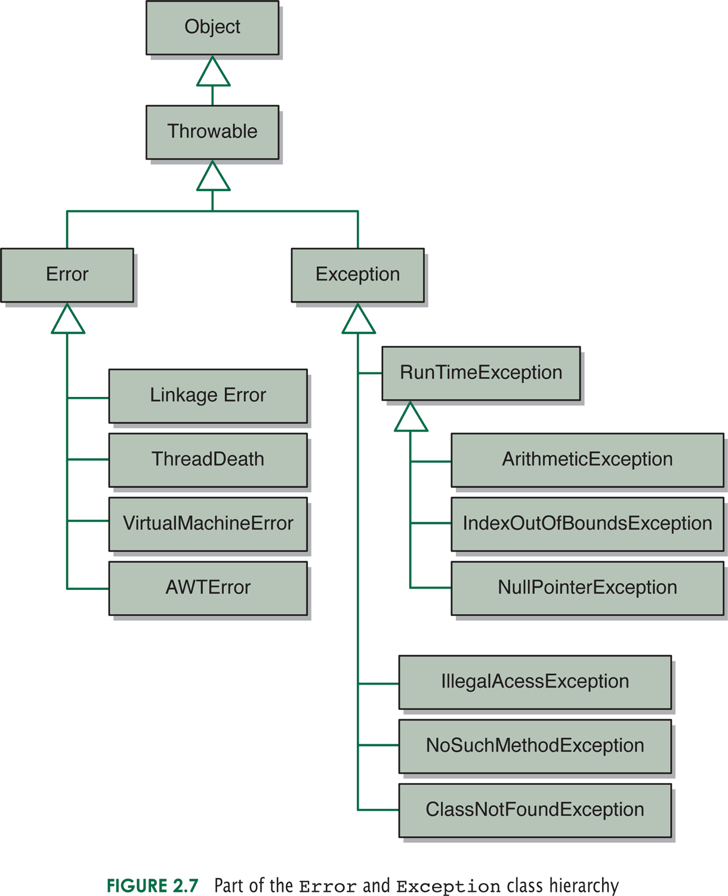
Some Java Error and Exception Classes

Slide 24
Runtime Errors
Java differentiates between runtime errors and exceptions
Errors are unrecoverable situations, so the program must be terminated
Example: running out of memory
24

Slide 25
Exceptions
Exception: an abnormal or erroneous situation at
runtime
Examples:
Division by zero
Array index out of bounds
Null pointer exception
Exceptions can be thrown by the program or by
the java virtual machine, for example for this statement
i = size / 0;
The virtual machine will throw an exception
25

Slide 26
Declaring Exception Classes
public class EmptyStackException extends RuntimeException {
public EmptyStackException (String mssg) {
super (mssg);
}
}
26

Slide 27
private static void method2(String str) {
if (str.length() > 0) ++x;
else
throw new Exception1(“Empty string”);
s = “hello”;
throw new Exception2(“Long string”);
}
public class ExceptionExample {
private static int x = 1;
private static String s = “”;
public static void main(String[] args) {
try {
method1(2);
method1(1);
x = x + 3;
}
catch (Exception1 e) {x = 0;}
catch (Exception2 ex) {x = x + 5;}
System.out.println(x+”, “+s);
}
private static void method1(int param) throws Exception1, Exception2 {
try {
if (param == 1) method2(“hello”);
else method2(s);
++x;
}
catch (Exception1 e) {
System.out.println(e.getMessage());
s = “hi”;
}
}
Execute by hand this
code. What is printed
by the program?

Slide 28
Checked and Unchecked Exceptions
Checked exceptions are checked by the compiler
Unchecked exceptions are not
28

Slide 29
Example: Checked Exception
import java.io.*;
class Main {
public static void main(String[] args) {
try {
FileReader file = new FileReader(“test.txt");
BufferedReader fileInput = new BufferedReader(file);
System.out.println(fileInput.readLine());
fileInput.close();
}
catch (FileNotFoundException e) { ... }
catch (IOException e) { ... }
}
}
29

Slide 30
Example: Checked Exception
import java.io.*;
class Main {
public static void main(String[] args) {
FileReader file = new FileReader(“test.txt");
BufferedReader fileInput = new BufferedReader(file);
System.out.println(fileInput.readLine());
fileInput.close();
}
}
The compiler gives the error:
Main.java:5: error: unreported exception FileNotFoundException; must be caught or declared to be thrown
FileReader file = new FileReader(“test.txt”);
30

Slide 31
Example: UnChecked Exception
class Main {
public static void main(String[] args) {
int x = 10;
int y = 0;
int z = x /y;
}
}
The compiler does not give an error even though we are
dividing by zero.
31

Slide 32
A Try-Catch Example with Multiple Catch Statements and a finally Block
The try-catch-finally syntax:
try {
code
}
catch(exception1 e) {statements}
catch(exception2 e) {statements}
catch(exception3|exception4 e){statements}
finally {statements}
32

Slide 33
Finally Block
The finally block always executes when the try block exits, whether an exception was thrown or not (even if the exception was not caught by any of the catch statements!)
The finally block is executed even if there is a return statement inside the try or catch blocks or if a new exception is thrown.
33

Slide 34
No finally Block
PrintWriter out;
try {
out = new PrintWriter(new FileWriter("OutFile.txt"));
out.println(“Data”);
int x = 5 / 0;
}
catch(FileNotFoundException e) {…}
catch(IOException e) {…}
if (out != null) out.close();
The exception caused by dividing 5 by 0 will not be caught, so the statement out.close() will not be executed, so the file will not be closed, and the data will not be stored in it.
34

Slide 35
Code with finally Block
PrintWriter out = null;
try {
out = new PrintWriter(new FileWriter("OutFile.txt"));
out.println(“Data”);
int x = 5 / 0;
}
catch(FileNotFoundException e) {…}
catch(IOException e) {…}
finally {
if (out != null) out.close();
}
The file will be closed.
35

